Slide 1


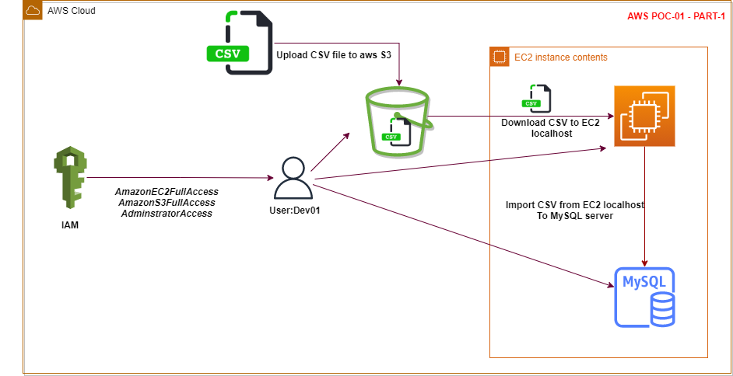


AWS POC-01
PART - 1
A developer needs his Mysql legacy Data setup on EC2[Linux] VM and should be shared to other developer through EBS volume
PRAFUL PATEL
AWS CPP, CSAA, Azure Admin
Regina, Canada
www.linkedin.com/in/praful-patel-b24489155
https://github.com/prafulpatel16/prafulpatel16.git

Slide 2
Architectural diagram
Presented By: Praful Patel, Regina, Canada

Slide 3
Agenda:
Create Group - Developer and add two users’ Dev01, Dev02
Assign appropriate permission to those users.
Assume user Dev01 has a database file in csv format.
Upload that csv data file to AWS S3 data bucket.
Create an EC2 Linux/ubuntu machine from Dev01’s user account
Download that csv data file from S3 data bucket to EC2 localhost using S3 endpoint.
Install MySQL server on EC2 localhost.
Create a Database and datatable.
Load csv data from EC2 localhost to MySQL server.
Validate that the csv data is correctly loaded into MySQL server.
Presented By: Praful Patel, Regina, Canada

Slide 4
Prerequisites:
AWS IAM Admin User
Datafile in csv format
Presented By: Praful Patel, Regina, Canada

Slide 5
Steps:
Find a CSV data file which has legacy data stored from your local disk.
Open AWS console - Create Dev Group and users, and login as user dev01
Create aws S3 bucket and upload the csv data file to s3 data bucket.
Create a aws EC2(Linux ubuntu machine).
Download the csv data file from S3 to EC2(ubuntu) localhost machine.
Install MySQL server into EC2 Linux machine and configure as required.
Create a required database and data table.
Import data csv file from localhost EC2 MySQL server database.
Run a query and Validate that the imported csv data file has all data uploaded into the datatable
Presented By: Praful Patel, Regina, Canada

Slide 6
Create Group & User
Task 1
Login to aws as IAM administrator login
(Note: Never use AWS root login to perform daily basis admin activities. )
Go to IAM services
Create a New User Group - Name: Developer
Assign Permissions:
a.AmazonEC2FullAccess
b.AmazonS3FullAccess
c.AdminstratorAccess
Presented By: Praful Patel, Regina, Canada

Slide 7
Create User
Task 2
Create User - Dev01 & Dev02
Click on Users - Add Users - Name: Dev01 & Dev02
Access Type: AWS Management console Access
Add user to group: Select - Developer
Presented By: Praful Patel, Regina, Canada

Slide 8
Create S3 bucket
Task 3
Create S3 bucket
Unblock all public access
Create bucket
Upload data csv to s3 bucket
Select csv and from the Actions-Make public
Presented By: Praful Patel, Regina, Canada

Slide 9
Create EC2 machine
Task 4
Open EC2 service
Launch instance
Choose an AMI Ubuntu Server 20.04 LTS (HVM), SSD ami-0801628222e2e96d6 (64-bit x86) / ami-0994658be3d2178e0 (64-bit Arm) (Free tier eligible)
Select t2.micro (Free tier eligible)
Fill up all configuration details
Add storage, default storage 8GB
Add tag Name: MySQL Server
Configure Security Group: Create new security Group: SSH 22
Review and Launch - Launch
Choose Create a new key pair - awskey
Launch Instance
Go to EC2 dashboard and select the running instance and click on connect to access instance for configuration.
Presented By: Praful Patel, Regina, Canada

Slide 10
Fetch the CSV file into EC2
Taks 5
Apply following command to fetch the csv file inside EC2 local
Download the csv file in EC2 local
#Wget < url of s3 endpoint for csv file >
Verify the file is present:
#ls
Verify the csv path of file
#readlink -f < csv file name >
Presented By: Praful Patel, Regina, Canada

Slide 11
Install MySQL Server on EC2
Task 6
Apply the following commands:
#sudo apt update
#sudo apt-get install mysql-server
To check the installed version of MySQL: #mysql --version
To install mysql secureway: #sudo mysql_secure_installation
To check mysql service is running: # sudo systemctl status mysql.service
To get into mysql: #sudo mysql
Presented By: Praful Patel, Regina, Canada

Slide 12
Install MySQL Server on EC2 Continue...
To check authentication method for mysql user
#mysql> select user, authentication_string, plugin, host from mysql.user;
To provide security to the user
#mysql> ALTER USER ‘root’@’localhost’ IDENTIFIED WITH caching_sha2_password by ‘mypassword’;
To login from the root account
#mysql -u root -p
Presented By: Praful Patel, Regina, Canada

Slide 13
Create database and datatable in MySQL
Task 7
List databases: mysql> Show databases;
Create a database: mysql> create database userdata;
To use database: mysql> use userdata;
Create datatable: mysql> create table userdetails(id int,first_name varchar(30),last_name varchar(30),email varchar(30),gender varchar(20));
Note: make sure that the column names are same name and order as in csv data file
To check the table: mysql> describe userdetails
Presented By: Praful Patel, Regina, Canada

Slide 14
Set local-infile settings
Task 8
using LOAD DATA INFILE to load large amount of data to database
Set the local infile settings on EC2 terminal
#mysql --local-infile=1 -u root -p
Set the global infile settings on mysql server
Log into mysql server: #sudo mysql -u root -p
Mysql > set global local_infile=true;
Presented By: Praful Patel, Regina, Canada

Slide 15
Import csv file to EC2 MySQL server
Task 9
Import csv file from ec2 local to mysql server
mysql> load data local infile '/home/ubuntu/userdata.csv' (path of csv file where it is saved in ec2 local)
-> into table userdetails
-> fields terminated by ','
-> enclosed by ' '
-> lines terminated by '\n'
-> ignore 1 rows;
Verify that csv data file is imported into mysql server data table
mysql> select * from userdetails;
Presented By: Praful Patel, Regina, Canada

Slide 16
PART -2 Continue...
Please follow
Part-2 for EBS volume mounting and dbbackup and db restore to Dev02’s EC2 machine.
Presented By: Praful Patel, Regina, Canada

Slide 17
Thank you
PRAFUL PATEL
AWS CPP, CSAA, Azure Admin
Regina, Canada
https://github.com/prafulpatel16/prafulpatel16.git
www.linkedin.com/in/praful-patel-b24489155

Slide 18
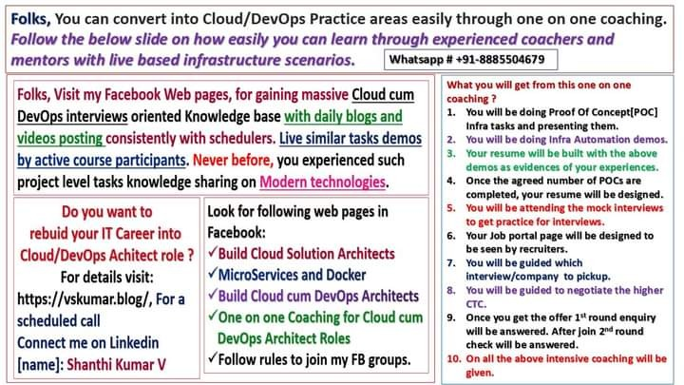
Coached by: Shanthi Kumar V

